Slide 1
NREGA Project
Satya Alekhya
DEVARAKONDA

Slide 2


AGENDA
* SC AND ST COMPARISON
SC Person days and ST Person days by district.
SC workers against and ST workers against active workers by district
Average of No. of Workers by district and Wages
Average of Approved Labour Budget by district

Slide 3
AGENDA
Job Holders
Active Job Cards and Job Cards issued by the district
Active Job Cards and Active Workers by district
Active Job Cards and Active Workers by district
Total No. of Workers by district

Slide 4

INTRO
This project delves into the analysis of data related to the National Rural Employment Guarantee Act (NREGA), a transformative government scheme aimed at providing rural households with guaranteed wage employment opportunities. The dataset used for this analysis encompasses a wide range of parameters, including the number of job cards issued, the workforce engaged, budget allocation, work completion statistics, and much more. Through the application of data analytics techniques, we aim to gain valuable insights into the implementation and impact of NREGA across different states and districts
in India..

Slide 5
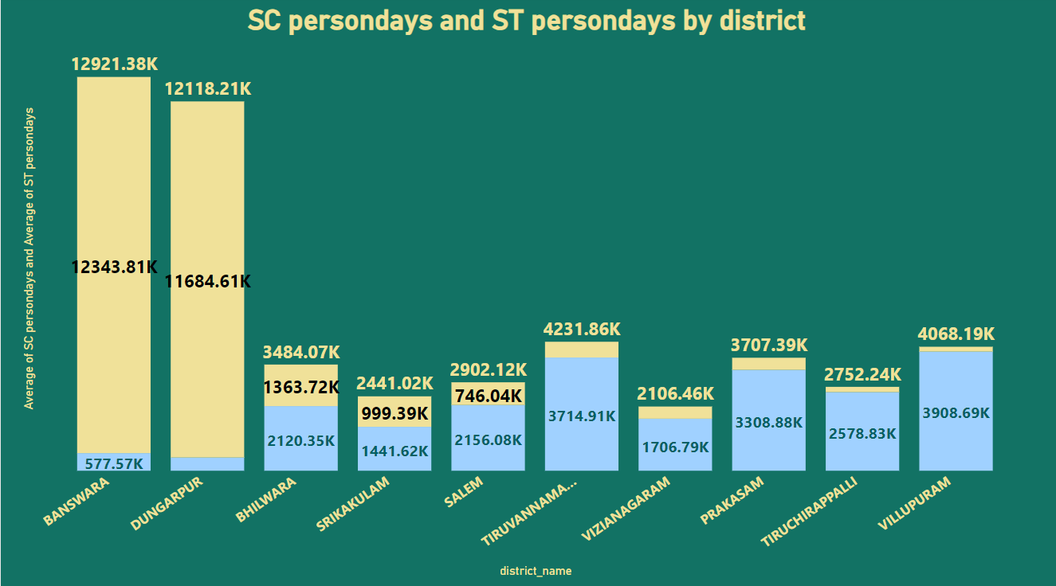
SC Persondays and ST Persondays by district

Slide 6
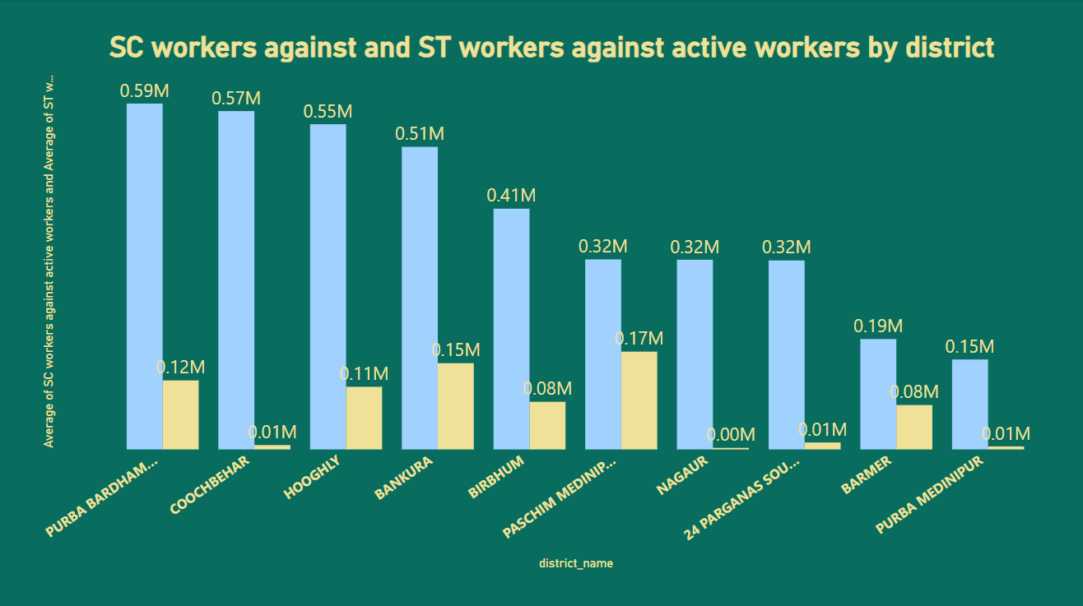
SC workers and ST workers active workers by district

Slide 7
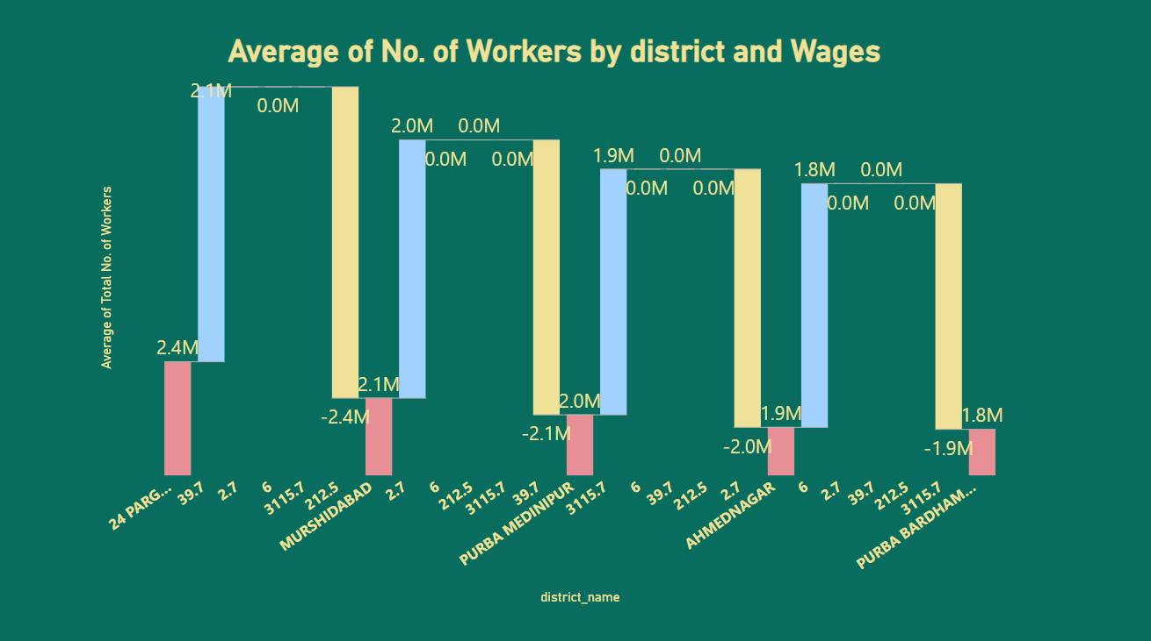
Average of No. OF Workers by district and Wages

Slide 8
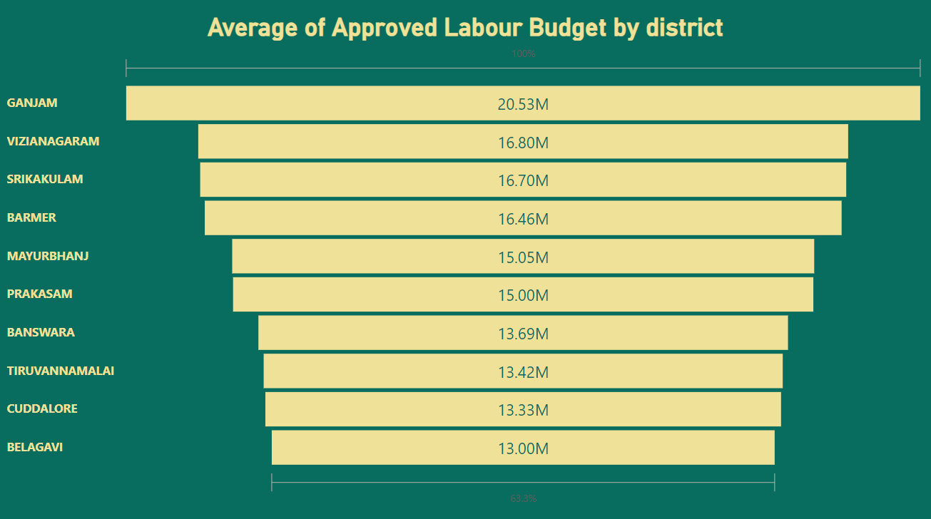
Average of Approved Labour Budget by district

Slide 9
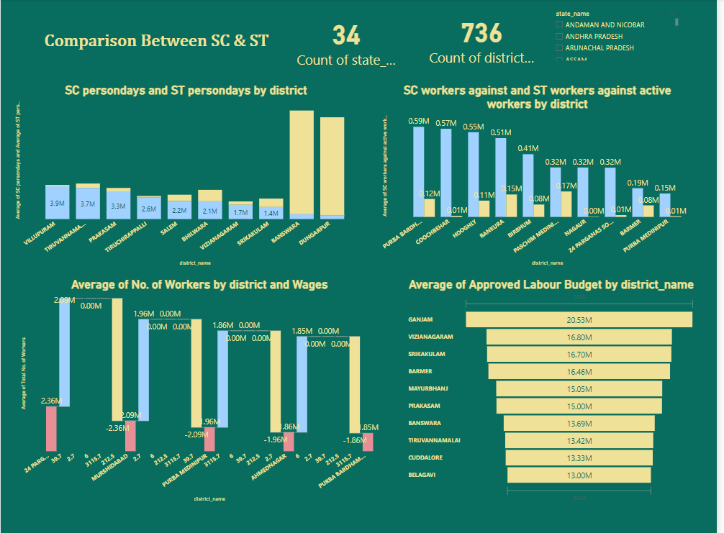
SC AND ST COMPARISON

Slide 10
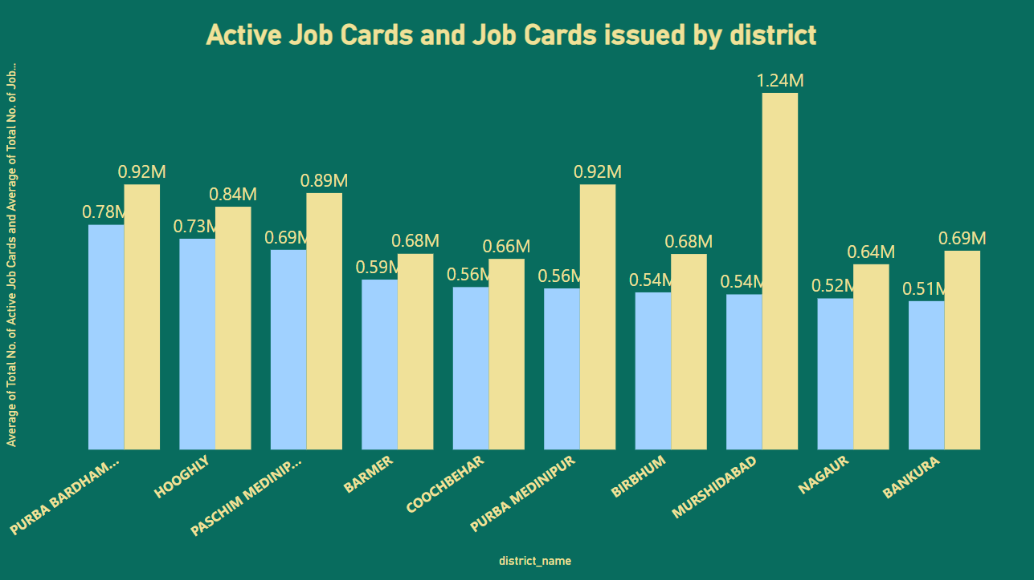
Active Job Cards and Job Cards issued by district

Slide 11
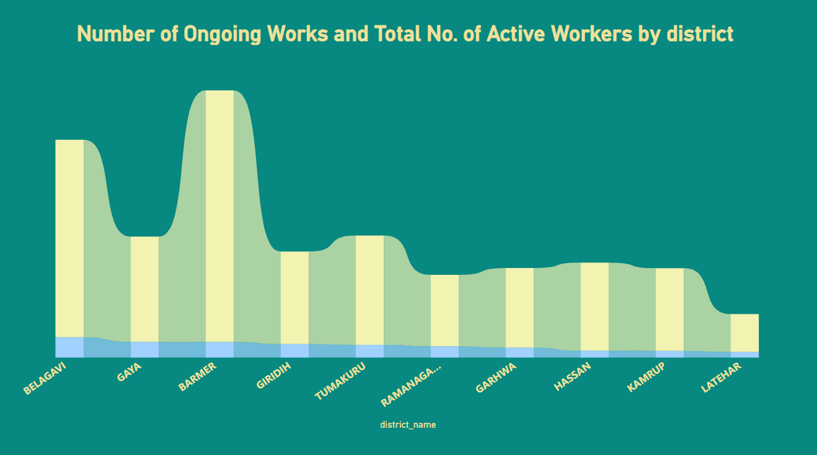
Number of Ongoing Works and Total No. of Active Workers by district

Slide 12
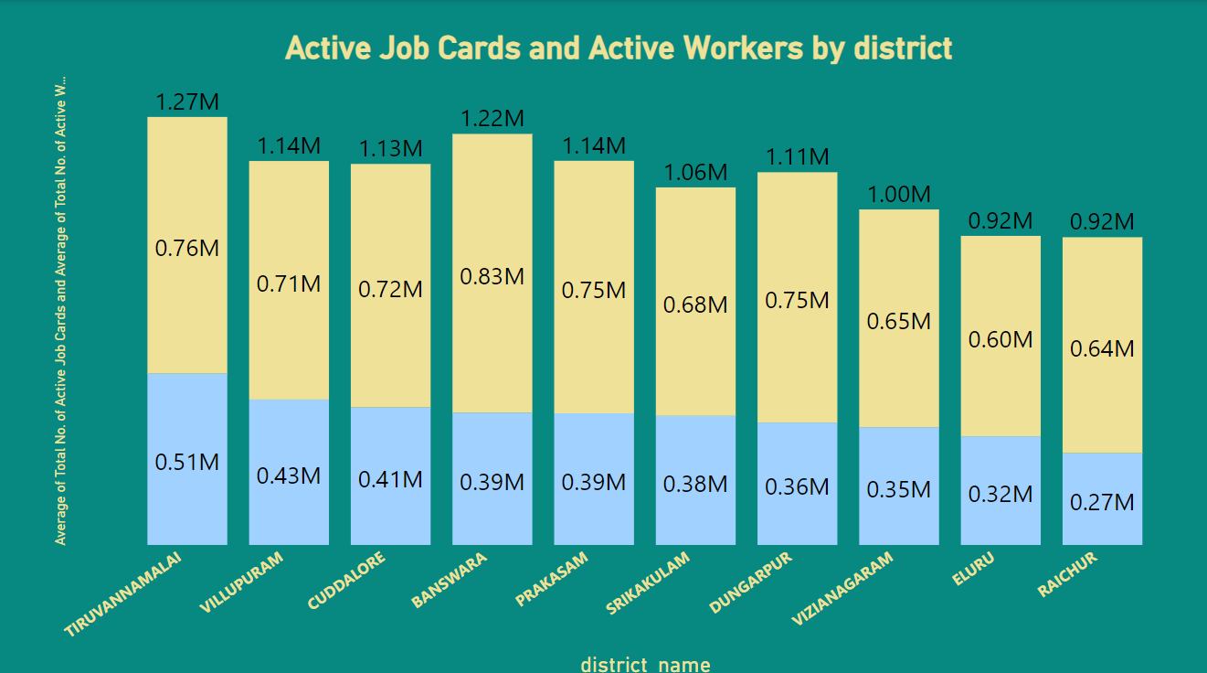
Active Job Cards and Active Workers by district

Slide 13
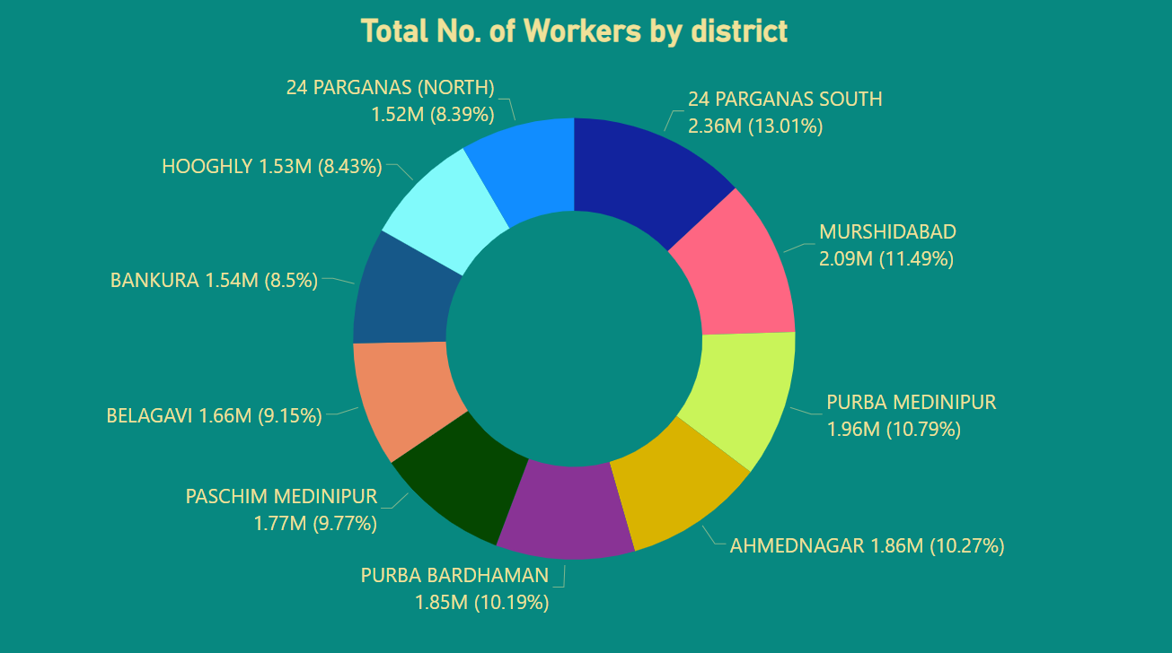
Total No. of Workers by district

Slide 14
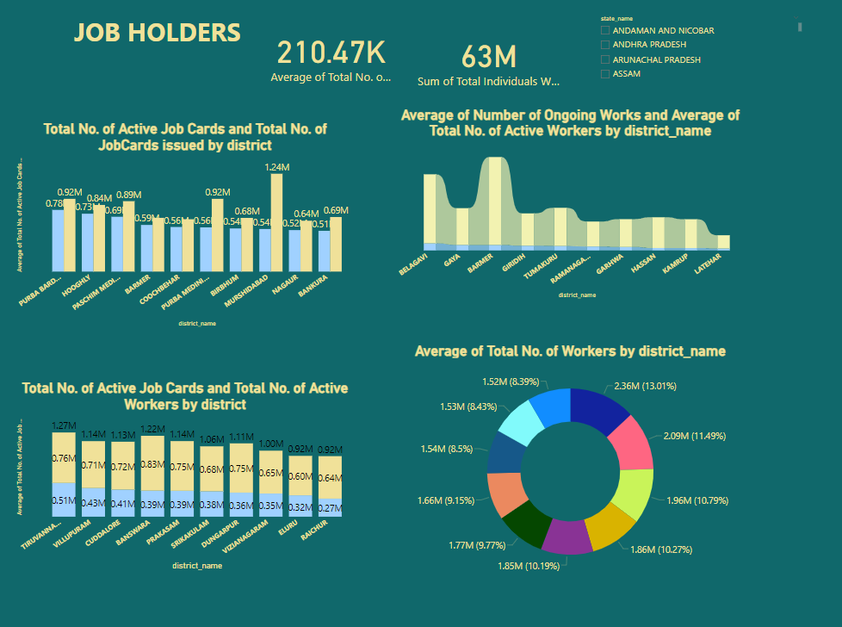
Job Holders

Slide 15

SUMMARY
Across all 10 district names, the Average of SC person-days ranged from 4,33,594.00 to 39,08,685.00 and the Average of ST person-days ranged from 1,59,506.00 to 1,23,43,806.00.﻿
Across all 10 district names, the Average of SC workers against active workers ranged from 1,52,685.00 to 5,87,213.00 and the Average of ST workers against active workers ranged from 2,644.00 to 1,66,056.00.
Across all 10 district names, the Average Total No. of Active Job Cards ranged from 5,14,439.00 to 7,78,650.00 and the Average Total No. of Job Cards issued ranged from 6,42,006.00 to 12,35,377.00.﻿
﻿Across all 10 district names, the Average Total No. of Active Job Cards ranged from 2,73,321.00 to 5,10,255.00 and the Average Total No. of Active Workers ranged from 5,96,941.00 to 8,30,112.00.
﻿Across all 10 district names, the Average Number of Ongoing Works ranged from 25,704.00 to 93,729.00 and the Average Total No. of Active Workers ranged from 1,74,860.00 to 11,59,592.00.
﻿ ﻿﻿

Slide 16
THANK YOU
Satya Alekhya Devarakonda
satyalekhyadsln@gmail.com

